Slide 1
Chapter 13 – Association Rules
Data Mining for Business Intelligence
Shmueli, Patel & Bruce

Slide 2
What are Association Rules?
Study of “what goes with what”
  “Customers who bought X also bought Y”
  What symptoms go with what diagnosis
Transaction-based or event-based
Also called “market basket analysis” and “affinity analysis”
Originated with study of customer transactions databases to determine associations among items purchased

Slide 3
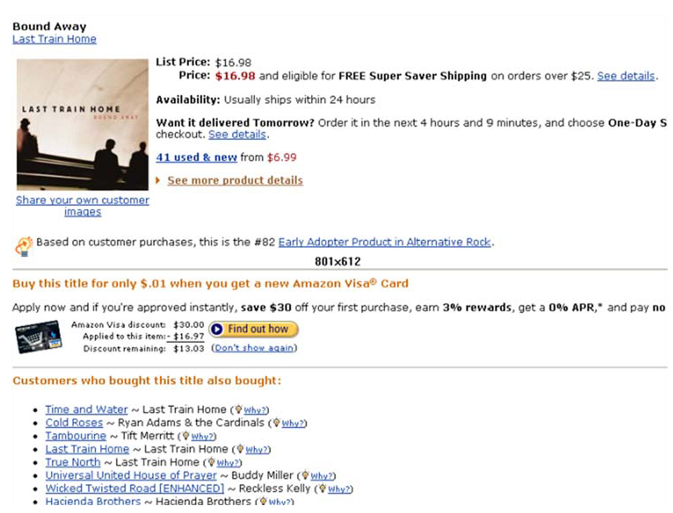
Used in many recommender systems

Slide 4
Generating Rules

Slide 5
Terms
“IF” part = antecedent
“THEN” part = consequent
“Item set” = the items (e.g., products) comprising the antecedent or consequent
Antecedent and consequent are disjoint (i.e., have no items in common)

Slide 6
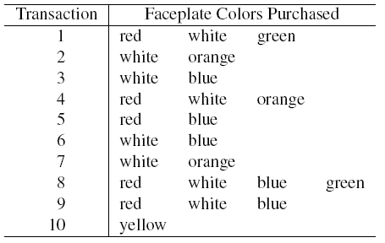

Tiny Example: Phone Faceplates

Slide 7
Many Rules are Possible
For example: Transaction 1 supports several rules, such as
  “If red, then white” (“If a red faceplate is purchased, then so is a white one”)
  “If white, then red”
  “If red and white, then green”
  + several more

Slide 8
Frequent Item Sets
Ideally, we want to create all possible combinations of items
Problem: computation time grows exponentially as # items increases
Solution: consider only “frequent item sets”
Criterion for frequent: support

Slide 9
Support
Support = # (or percent) of transactions that include both the antecedent and the consequent
Example: support for the item set {red, white} is 4 out of 10 transactions, or 40%

Slide 10
Apriori Algorithm

Slide 11
Generating Frequent Item Sets
For k products…
User sets a minimum support criterion
Next, generate list of one-item sets that meet the support criterion
Use the list of one-item sets to generate list of two-item sets that meet the support criterion
Use list of two-item sets to generate list of three-item sets
Continue up through k-item sets

Slide 12
Measures of Performance
Confidence: the % of antecedent transactions that also have the consequent item set
Lift = confidence/(benchmark confidence)
Benchmark confidence = transactions with consequent as % of all transactions
Lift > 1 indicates a rule that is useful in finding consequent items sets (i.e., more useful than just selecting transactions randomly)

Slide 13
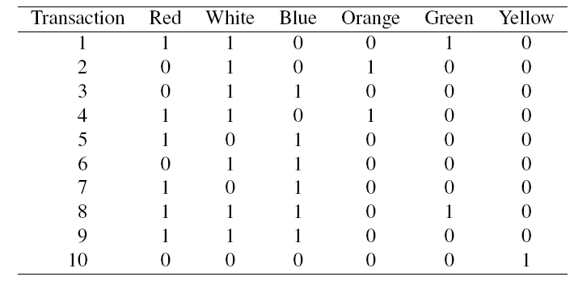
Alternate Data Format: Binary Matrix

Slide 14
Process of Rule Selection
Generate all rules that meet specified support & confidence
  Find frequent item sets (those with sufficient support – see above)
  From these item sets, generate rules with sufficient confidence

Slide 15
Example: Rules from {red, white, green}
{red, white} > {green} with confidence = 2/4 = 50%
  [(support {red, white, green})/(support {red, white})]
{red, green} > {white} with confidence = 2/2 = 100%
  [(support {red, white, green})/(support {red, green})]
Plus 4 more with confidence of 100%, 33%, 29% & 100%
If confidence criterion is 70%, report only rules 2, 3 and 6

Slide 16
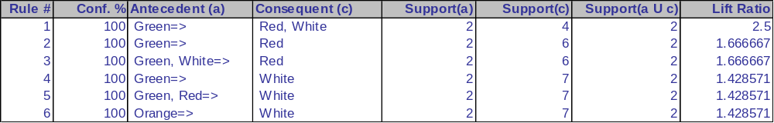
All Rules (XLMiner Output)

Slide 17
Interpretation
Lift ratio shows how effective the rule is in finding consequents (useful if finding particular consequents is important)
Confidence shows the rate at which consequents will be found (useful in learning costs of promotion)
Support measures overall impact

Slide 18
Caution: The Role of Chance
Random data can generate apparently interesting association rules
The more rules you produce, the greater this danger
Rules based on large numbers of records are less subject to this danger

Slide 19
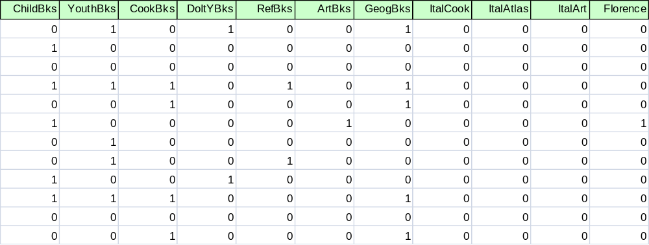
Example: Charles Book Club
Row 1, e.g., is a transaction in which books were bought in the following categories: Youth, Do it Yourself, Geography

Slide 20
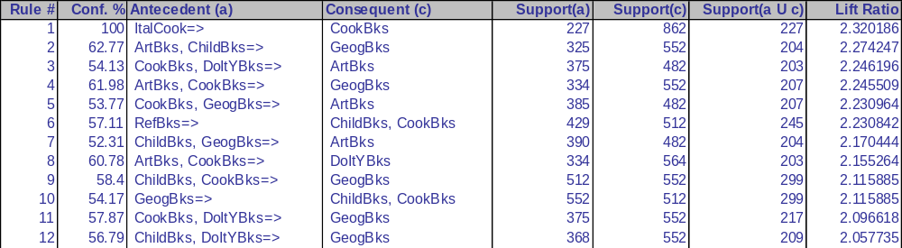
XLMiner Output
Rules arrayed in order of lift
Information can be compressed
  e.g., rules 2 and 7 have same trio of books

Slide 21
Summary
Association rules (or affinity analysis, or market basket analysis) produce rules on associations between items from a database of transactions
Widely used in recommender systems
Most popular method is Apriori algorithm
To reduce computation, we consider only “frequent” item sets (=support)
Performance is measured by confidence and lift
Can produce a profusion of rules; review is required to identify useful rules and to reduce redundancy

